Slide 1
Benchmarking GNNs, DL, and ML for Neurological Disorder Classification
-A Graph-Based Approach to Functional Brain Connectomes
Notes:
Hello everyone, good morning.
Today, I’ll be presenting my research proposal on Benchmarking Graph Neural Networks, Deep Learning, and Classical Machine Learning for Neurological Disorder Classification. This is essentially about how we can leverage AI to better understand and diagnose brain disorders.

Slide 2
Course: Basic Graph Theory
Name & ID
Name | ID
22-46862-1 | Rakesh Karmaker
21-44414-1 | Rukaiya Islam
21-44425-1 | Khandkar Md.Antik Mahmud

Slide 3
Table of contents
01
02
03
04
05
06
Table Of Contents
Introduction & Background
Problem Statement
Objective
Literature Review
Methodology
07
08
09
Expected Outcomes
Timeline & Resources
References

Slide 4
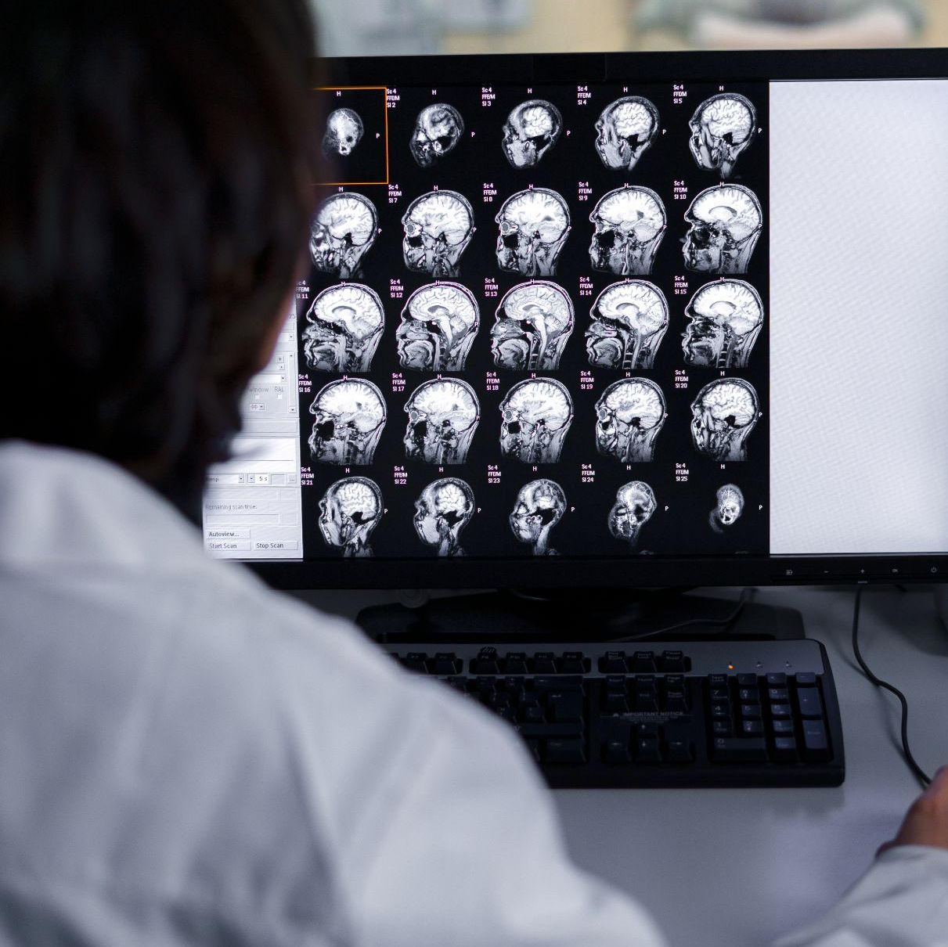
Concerns!
"Over 55 million people worldwide live with dementia, a number expected to nearly double every 20 years.“
It is Estimated to reach 78 million by 2030 and 139 million by 2050, according to the World Health Organization (WHO)
Notes:
Our motivation is rooted in a pressing health crisis: over 55 million people worldwide live with dementia, and this number is expected to double every 20 years. Brain diseases such as Alzheimer’s, Parkinson’s, stroke, and epilepsy are notoriously difficult to diagnose early.

Slide 5
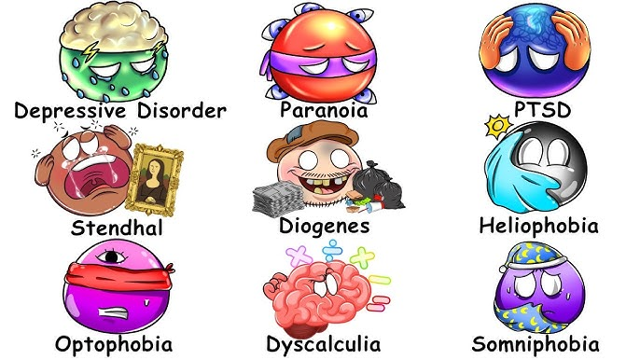
Types of Brain Diseases
1. Neurodegenerative
Alzheimer’s
Parkinson’s
Multiple Sclerosis
2. Vascular Diseases
Stroke
3. Infections
Meningitis
Encephalitis
4. Epilepsy
5. Brain Tumors
Notes:
Neurodegenerative Diseases 🧠
Alzheimer’s: Memory & cognition decline
Parkinson’s: Movement & coordination disorder
Multiple Sclerosis: Immune system attacks nerves
Vascular Diseases
Stroke: Brain cell death due to blocked or burst blood vessel
Infections 🦠
Meningitis: Infection of brain membranes
Encephalitis: Inflammation of brain tissue
Epilepsy ⚡
Seizures from abnormal brain electrical activity
Brain Tumors 🎯
Abnormal growths affecting brain function
Head Injuries 💥
Concussions & traumatic brain injuries

Slide 6

Early and accurate diagnosis is critical. Can AI help
?

Slide 7
02
Introduction & Background

Slide 8
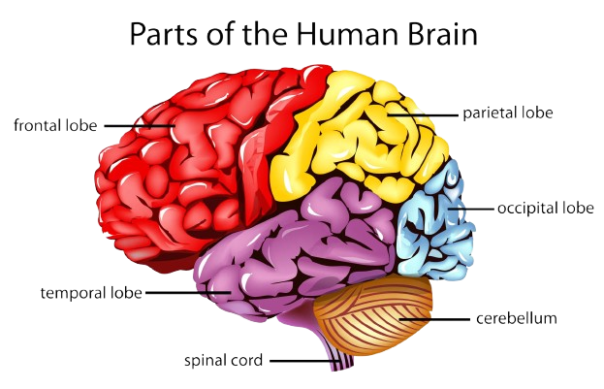
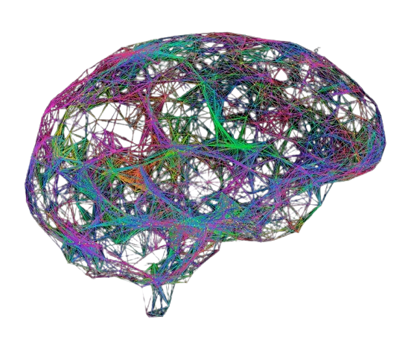
The Brain as a Network
The brain is a complex system of interconnected regions.
Functional Connectomes model this system as a graph:
Nodes: Brain Regions (ROIs from an atlas like AAL).
Edges: Functional Connectivity (e.g., correlation of fMRI signals).
Brain as Network
Notes:
With AI & GNNs lies the opportunity!
the brain is like a giant network, where each region is a node and the connections between them are edges. By modeling the brain as a graph, we can use AI to capture subtle communication breakdowns that happen long before symptoms appear.”

Slide 9
The Challenge & The opportunity
The Clinical Challenge:
Neurological disorders (Alzheimer's, Autism, Parkinson's) are often network disorders.
They disrupt the normal communication pathways between brain regions long before severe symptoms appear.
The Opportunity:
ML, DL, GNN can detect these subtle, early changes in brain networks from neuroimaging data.
Notes:
Graph Neural Networks, however, are natively designed for graph structures. They can process both node-level features and the overall connectivity pattern. Yet—here’s the research gap—we lack rigorous benchmarks that compare ML, DL, and GNNs on the same datasets under the same conditions.”

Slide 10
03
Problem Statement

Slide 11
Problem Statement
Existing Methods Have a Blind Spot:
Classical ML (SVM, Random Forest): Flattens the connectivity matrix into a vector, destroying all topological information.
Deep Learning (CNN, MLP): Struggles with the non-Euclidean, graph-structured nature of connectomes. Treating the matrix as an image is suboptimal due to arbitrary node ordering.
The Promise of GNNs:
Graph Neural Networks are natively designed to operate on graph structures.
They can learn from both node features and the graph structure simultaneously.
Research Gap: A lack of rigorous, controlled benchmarks directly comparing these three paradigms on a level playing field using the same data and metrics.
Notes:
Research Gap:
A lack of rigorous, controlled benchmarks directly comparing these three paradigms on a level playing field using the same data and metrics.

Slide 12
04
Objective

Slide 13
Objective
1. Benchmarking ML, DL, GNN
Systematically implement, train, and evaluate representative models from three families:
2. Hybrid Model Exploration
Propose and evaluate a hybrid pipeline using GNN-derived embeddings as input for classical anomaly detectors (e.g., Isolation Forest).
3. Robustness Analysis
Test model performance under realistic challenges: noise, sensor drop-out (simulated), and cross-dataset generalization.
Notes:
Our work has three objectives:
Systematically benchmark ML, DL, and GNN models on brain connectivity data.
Explore a hybrid pipeline — for example, using GNN embeddings as inputs to anomaly detection methods like Isolation Forest.
Analyze robustness, by testing models under noise, sensor drop-out, and cross-dataset scenarios.

Slide 14
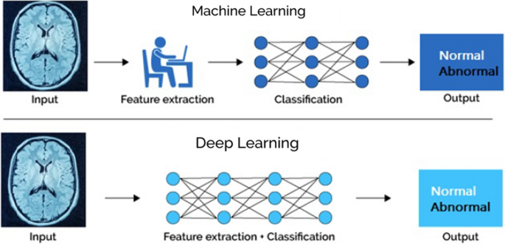
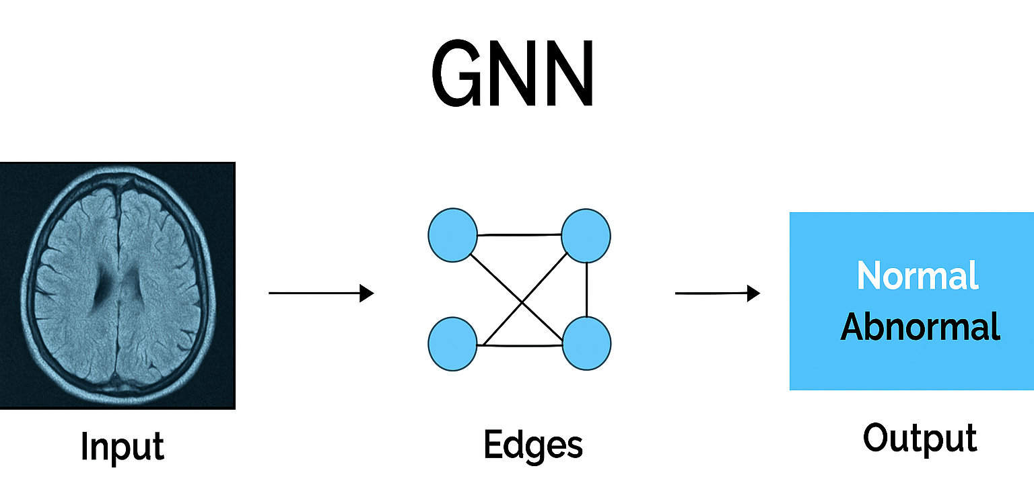
Model Objective
Classical ML
Deep Learning
Graph Neural Networks
SVM,
Random Forest
ETC,
CNN
UNET/UNET++
MLP
1D-CNN
GCN
GAT
Notes:
This project aims to provide a definitive empirical comparison of modeling paradigms for brain network classification.
Benchmarking: Systematically implement, train, and evaluate representative models from three families:
Classical ML (SVM, Random Forest)
Deep Learning (MLP, 1D-CNN)
Graph Neural Networks (GCN, GAT)
Hybrid Model Exploration: Propose and evaluate a hybrid pipeline using GNN-derived embeddings as input for classical anomaly detectors (e.g., Isolation Forest).
Robustness Analysis: Test model performance under realistic challenges: noise, sensor drop-out (simulated), and cross-dataset generalization.

Slide 15
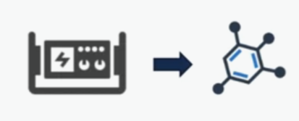
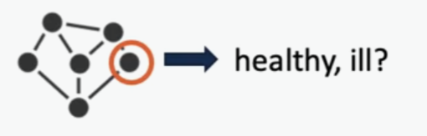
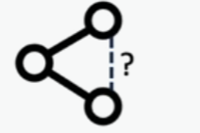
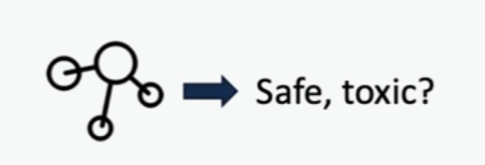
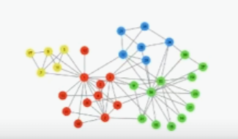
Tasks on Graphs
Node
Classification
Link
Prediction
Graph Generation
Graph Property Prediction
Community Detectionn

Slide 16
05
Literature Review

Slide 17
Literature Review
Paradigm | Key Findings | Limitations
Classical ML | Effective on flattened features [6][7]. Good baseline performance. | Ignores spatial dependencies and graph structure.
Deep Learning | CNNs can improve feature extraction [4]. LSTMs model temporal dynamics. | Not designed for non-Euclidean data. Struggles with arbitrary graph structure.
Graph Neural Networks | Show great promise in modeling brain topology [11] [12] [13]. | Literature is fragmented. Lack of direct, standardized comparisons.
Gap: While each approach has merits, a comprehensive benchmark is needed to guide future research and clinical application.
Notes:
While each approach has merits, a comprehensive benchmark is needed to guide future research and clinical application.
While there are many papers applying each of these methods individually, a comprehensive, head-to-head benchmark is missing. This project will fill that gap and help guide both researchers and clinicians toward the most effective approaches.

Slide 18
06
Methodology

Slide 19
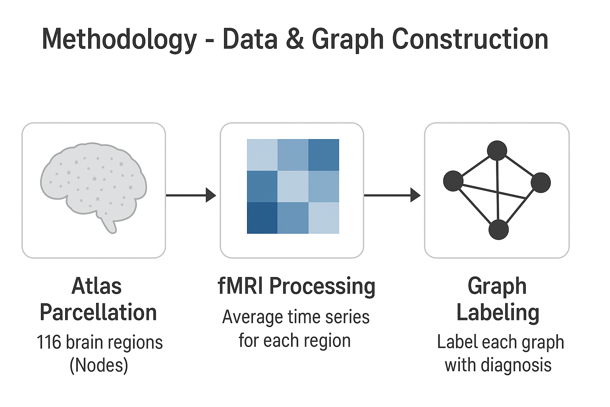
Data & Graph Construction
Datasets: ADNI (Alzheimer's) & ABIDE (Autism) public datasets.
Preprocessing Pipeline:
Atlas Parcellation: Use AAL atlas to define 116 brain regions (Nodes).
fMRI Processing: Extract average time series for each region.
Connectivity Matrix: Calculate Pearson correlation between all region pairs (Edges).
Graph Labeling: Label each subject's graph with their diagnosis (e.g., AD vs. Healthy Control).
Notes:
“We’ll use public datasets: ADNI for Alzheimer’s and ABIDE for Autism. Here’s the workflow:
First, we parcellate the brain into 116 regions using the AAL atlas.
Next, extract time series from fMRI scans.
Then compute correlations between regions to build connectivity matrices.
Finally, represent these as graphs labeled with diagnoses.

Slide 20
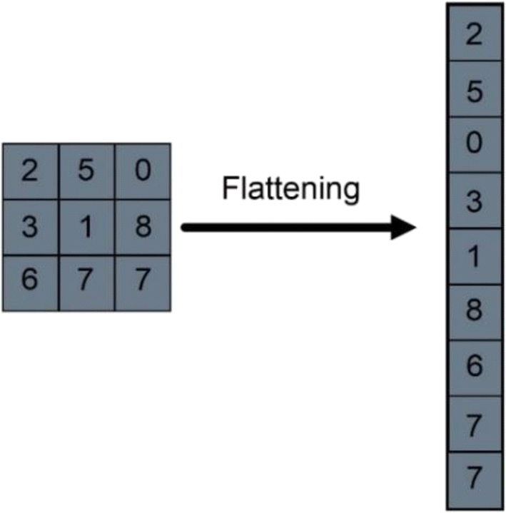
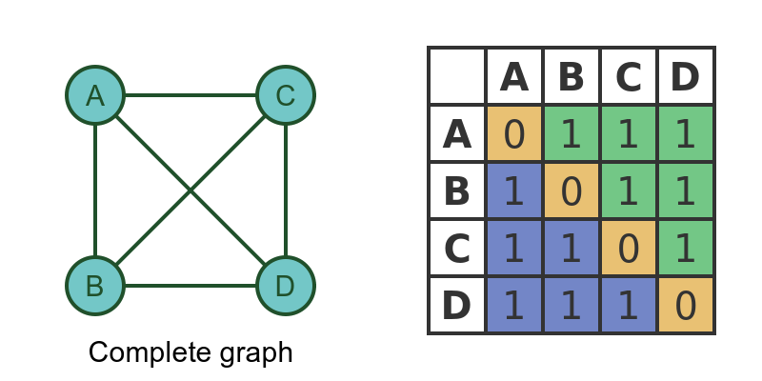
Model Architecture
Input Representations:
ML/DL: Flattened upper triangle of the correlation matrix.
GNN: Native graph structure (Node Features X + Adjacency Matrix A).
Models to Benchmark:
ML (scikit-learn): SVM, Random Forest.
DL (PyTorch): MLP, 1D-CNN, CNN, UNET/UNET++.
GNN (PyTorch Geometric): GCN, GAT.
Evaluation:
Stratified 5-Fold Cross-Validation using
Accuracy, F1-Score, AUC-ROC.
Notes:
Classical ML will use flattened matrices. DL models will take matrix-like inputs. And GNNs will directly use the graph structure. We’ll benchmark SVMs, Random Forests, CNNs, MLPs, GCNs, and GATs — using metrics like accuracy, F1-score, and AUC-ROC.”

Slide 21
07
Expected Outcomes

Slide 22
Expected Outcomes
Performance Hierarchy: We expect a clear result: GNN > DL > ML in classification metrics, demonstrating the critical importance of preserving graph structure.
Novel Hybrid Pipeline: We will determine if a GNN hybrid model offers a superior accuracy/compute trade-off for potential real-time applications.
Robustness Insights: We will quantify which model type generalizes best across datasets and is most resilient to noisy, incomplete data.
Interpretability: By using tools like GNNExplainer, we will try to identify the brain sub-netjects most salient for prediction, providing potential biomarkers.
Notes:
We anticipate three key outcomes:
GNNs will outperform DL, which will outperform ML — proving the importance of preserving graph structure.
Our hybrid models may provide the best balance between accuracy and efficiency.
We’ll gain robustness and interpretability insights, for example, identifying which brain subnetworks are most important for predictions.”

Slide 23
08
Timeline & Resources

Slide 24
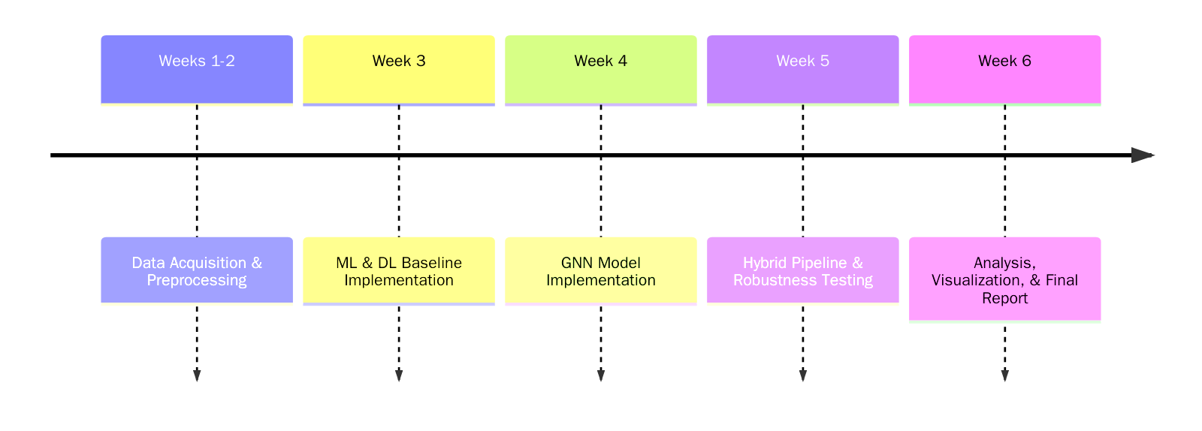
Timeline

Slide 25
Resources
Data:
ADNI, ABID etc.
Software:
Python, PyTorch, PyTorch Geometric, scikit-learn, Nilearn
Jupyter Notebook, Anaconda
Hardware:
NVIDIA RTX 3060 GPU
AMD Ryzen 7 5700X CPU
32GB RAM
Reproducibility & Team Communication Purposes:
All code will be made publicly available on GitHub.
Notes:
The project will use open datasets, Python, PyTorch, and scikit-learn, with NVIDIA RTX GPUs. All code will be shared on GitHub to ensure reproducibility. Our timeline includes preprocessing and model development first, followed by benchmarking, robustness testing, and final analysis.

Slide 26
09
Reference

Slide 27
References
[1] Kim, H., Lee, B. S., Shin, W.-Y., & Lim, S. "Graph Anomaly Detection with Graph Neural Networks: Current Status and Challenges," arXiv:2209.14930, Sep. 2022.
[2] Pang, G., Shen, C., Cao, L., & van den Hengel, A. "Deep Learning for Anomaly Detection: A Review," ACM Computing Surveys, vol. 54, no. 2, Mar. 2021.
[3] Gao, Y., Zhu, Q., Shi, X., & Jin, H. "A Transformer-Based Spatio-Temporal Graph Neural Network for Anomaly Detection on Dynamic Graphs," in Big Data, Springer, Jan. 2025. (Relevant for advanced spatio-temporal modeling).
[4] Schummer, P., del Rio, A., Serrano, J., et al. "Machine Learning-Based Network Anomaly Detection: Design, Implementation, and Evaluation," AI, vol. 5, no. 4, 2024.
[5] Sattar, S., Khan, S., Khan, M.I., et al. "Anomaly Detection in Encrypted Network Traffic Using Self-Supervised Learning," Scientific Reports, vol. 15, 2025. (Relevant for hybrid/unsupervised approaches).
[6] T. N. Kipf and M. Welling, "Semi-Supervised Classification with Graph Convolutional Networks," in International Conference on Learning Representations (ICLR), 2017. This is the foundational paper for Graph Convolutional Networks (GCNs), the architecture upon which many modern neuroimaging GNNs are built. It is essential for justifying the choice of GCN as a baseline model.
[7] X. Li, Y. Zhou, N. Dvornek, M. Zhang, S. Gao, J. Zhuang, D. Scheinost, L. H. Staib, P. Ventola, and J. S. Duncan, "Pooling Regularized Graph Neural Network for fMRI Biomarker Analysis," in Medical Image Computing and Computer Assisted Intervention (MICCAI), 2020, pp. 625–635. This paper directly applies a regularized GNN to fMRI data for autism biomarker discovery, providing a strong, directly relevant methodological precedent for your work.
[12] H. Peng, S. Li, Y. Jiang, H. Lu, Y. Fang, K. Li, and S. Yu, "Graph Neural Networks for Brain Graph Analysis: A Survey," ACM Computing Surveys, 2023. This recent survey paper is an excellent resource for your introduction and literature review, as it comprehensively covers the state-of-the-art in applying GNNs to brain graphs, including various architectures and tasks.
Notes:
Our references include foundational works in GNNs, recent surveys, and cutting-edge papers applying these methods to brain connectomes.
To conclude: this project doesn’t just benchmark algorithms — it takes us closer to AI-powered, early, and reliable diagnosis of neurological disorders. Thank you.

Slide 28
Thank You

